Slide 1
Microservices and RESTful API
Classroom

Slide 2
Communication between Microservices
East/West – Load Balancing
North/South – API Gateway
Additional Options
Service Discovery
Application Layer Networking
East/West is internal communication between microservices
North/South is communication from external sources or customers
Notes:
With large numbers of microservices communicating with each other, there can be challenges to not only provide a secure entry point into our application but allow any communication to scale.
Sometimes terminology such as East/West North/South is used to try to identify the origin and flow of the communication to our microservices. Typically East/West communication is internal communication between microservices and using services such as load balancers and application layer networking. North/South typically describes communication originating from external sources or customers. An API gateway could be used to support this scenario (would support East/West too*).
*Many of the services described to facilitate communication can be used in both North/South and East/West scenarios. As always find the best combination of tools and services to do the job in the most efficient and secure manner.

Slide 3
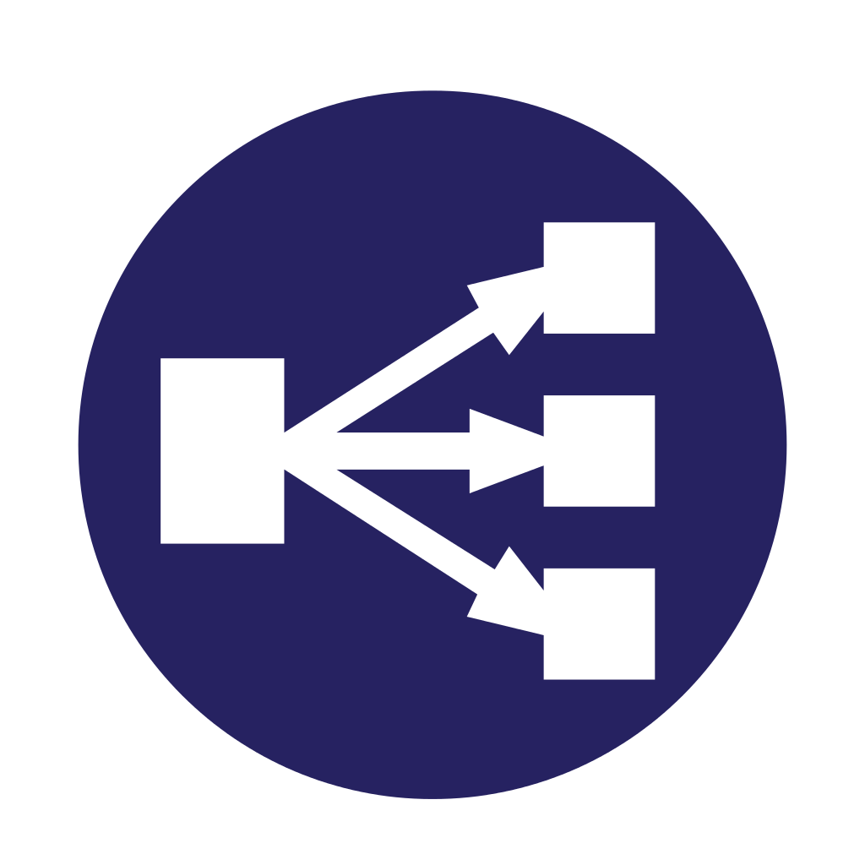
Communication between Microservices
East/West – Load Balancing
Introduction to AWS Step Functions
Registered Microservices
Calling service
‘hard code’ the endpoint
use Static URL
What if a service dies?
AWS ELB
🤦‍♂️
Notes:
As one microservice communicates with another we could ‘hard code’ the endpoint we need to communicate with. Having a static URL for a HTTP endpoint or IP address for TCP/UDP communication specified in the code does not allow for scalability, redundancy or disposability. Whilst applying generally as a good practice, with the flexibility of the cloud this is even more important.
The cloud allows easy scaling of resources. One microservices may need to talk to and load balance amongst many instances of the same microservice as demand increases and that individual microservice scales to many instances.
If a microservice died, with the correct service being used to host it, it should automatically be re-provisioned. However it may come up with a different endpoint.
And as we are using the cloud, if we don’t need something we should dispose of it. Let's not feed something we do not need. This will save cost. When we do need it we will then provision it.
In all the above cases we need a more flexible and dynamic way of connecting to the microservices.
This can be done by using a load balancer as the common endpoint for a service and the load balancer distributing the calls to the registered microservices.

Slide 4
Communication between Microservices
East/West – Load Balancing
AWS ELB
SCNE – Out to extra Nodes
A
AZ-1
B
AZ-1
Calling service
Microservices across availability zones
Notes:
The AWS Elastic Load Balancer service is a manged services that is fault tolerant and scalable. It can be AZ aware so that it can be spread across multiple locations within a region. If a location goes offline the traffic continues in the remaining location within that region until we can come online with another AZ again.
The UK (London) Region has 3x AZs (Availability Zones)

Slide 5
Communication between Microservices
East/West – Load Balancing
AWS ELB
Application Load Balancer (HTTP)
Network Load Balancer (TCP/UDP)
Classic load Balancer – Deprecated (HTTP/TCP)
(Classic) LB needed to be replaced by ALB and NLB
ALB & NLB can work internally or with the internet
NLB can register containers (using ECS) running microservices
Notes:
The Elastic Load Balancer comes in three flavours:
Application Load Balancer (ALB)
Network Load Balancer(NLB)
Classic Load Balancer. The original NLB that is now deprecated. As it is not designed to work with containers and microservices we will not cover this further.
The Application load Balancer is designed to handle layer 7 OSI traffic. It can accept HTTP and HTTPS traffic. If the traffic is secured with SSL/TLS it can terminate this at the load balancer.
HTTP request headers are inspected to allow direction of traffic to endpoints based on the HOST or PATH based portion of the URL. It can also use other elements of the header such as AGENT information to make routing decisions.
One of the significant additions over its predecessor, the original NLB (now Classic Load Balancer) is the ability to register ECS (Elastic Container Service) containers running our microservices against it. Programmatically other container / microservice solutions could be also registered.
To bring the family up to date the NLB (Classic) needed to be replaced,. The new Network load Balancer has greater throughput, support for SSL/TLS passthrough or termination and also now support for UDP as well as TCP traffic. Again a useful addition is the ability to register containers running our microservices. If we are communication with our microservices at a port level, layer 4 OSI, this NLB can distribute traffic to them
Finally, there are two further options with the ELB. When you deploy an ALB or NLB cluster you can choose whether to use it internally or to expose it to the internet. Hence, we choose an ‘internal’ or ‘internet facing’ cluster as we deploy our ELB Cluster.
If extreme speed is required, use NLB (0.0225) which are 2.8 times more expensive than ALB (0.008 per hour)

Slide 6
AWS Fargate is a compute engine for Elastic Container Service (ECS)
Can create and deploy containers with no need to set up servers
You will use Elastic Container Registry (ECR) + ECS to create a managed Docker repository for your images
You will use S3 and IAM to manage your containers.
You will build a Docker container image with Amazon CodeBuild, push the image to ECR, and deploy using ECS with Fargate.
Lab Objectives
Create Docker container images and place them in Amazon ECR
Create an Amazon ECS cluster
Use the ECR images to create ECS task definitions and services
Implement the services in ECS by using AWS Fargate enjoying the advantages of serverless
Register ECS tasks with an Application Load Balancer (ALB) target group
Lab

Slide 7
Lab Activity
You'll use Cloud Academy to explore once again the use of ECS for Containerisation
The example given uses Fargate for Serverless deployment together with a ELB for Microservice to Microservice communication (East/West configuration)
Use AWS Fargate for Serverless Deployment of Container Applications
Duration: 2 hours
Notes:
https://app.qa.com/lab/use-aws-fargate-serverless-deployment-container-applications/ (approx. 2hrs)

